Slide 1
Introduction to REST APIs
Olivier Liechti & Simon Oulevay
COMEM Web Services 2016

Slide 2


Big Web Services vs REST

Slide 3




What is a Web Service?
Logic
+
Data
Network
How do they...
...find each other?
...know what logic can be invoked?
...talk to each other?
Clients

Slide 4
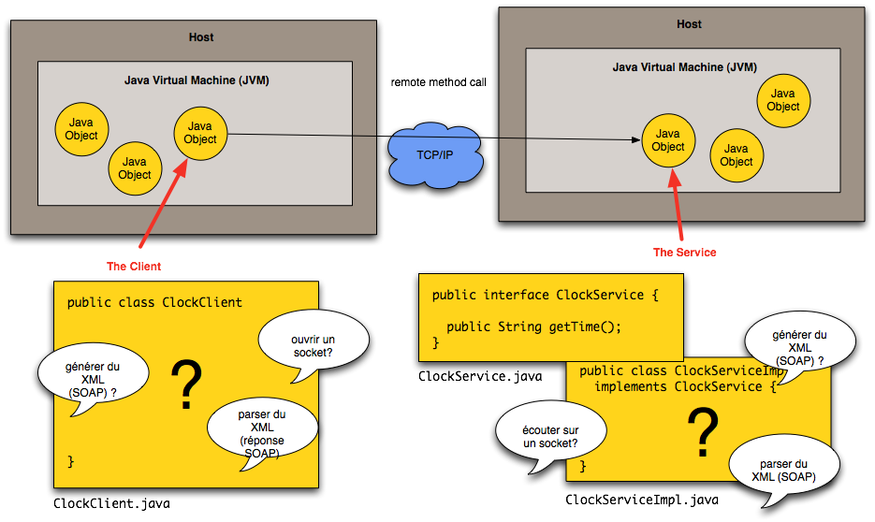
Remote services in Java (RMI)

Slide 5
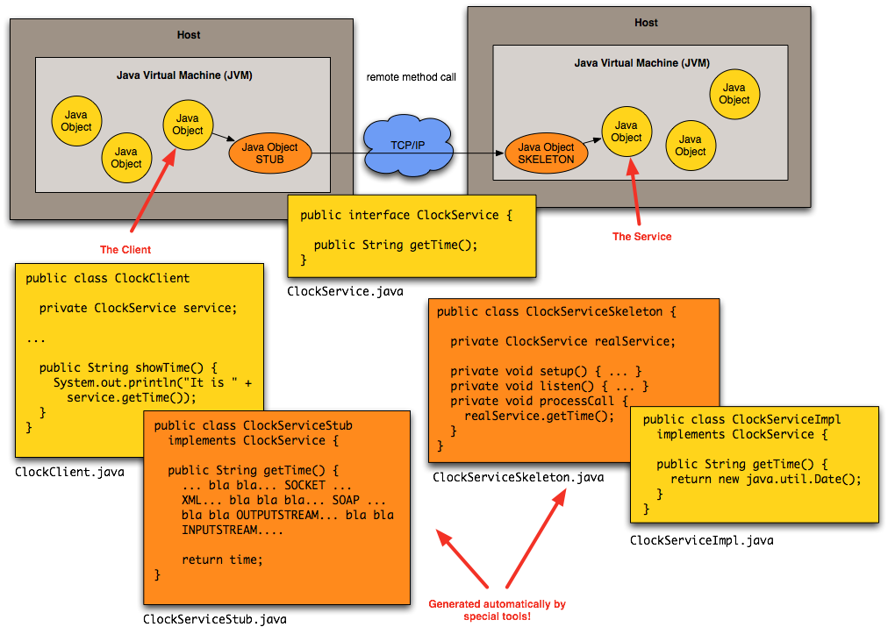
Remote services in Java (RMI)

Slide 6
The “Big” Web Services Approach

Slide 7
Big Web Services
Approach
  Services are often designed and developed with a RPC style (even if Document-Oriented Services are possible).
Core Standards
  Simple Object Access Protocol (SOAP)
  Web Services Description Language (WSDL)
Benefits
  Very rich protocol stack (support for security, transactions, reliable transfer, etc.)
Problem
  Very rich protocol stack (complexity, verbosity, incompatibility issues, theoretical human readability, etc.)

Slide 8
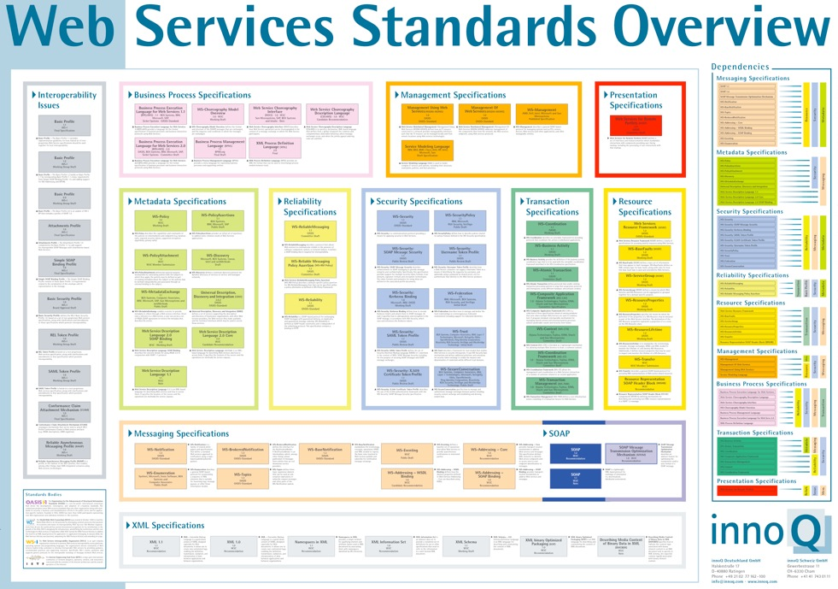
http://www.innoq.com/soa/ws-standards/poster/
http://www.innoq.com/soa/ws-standards/

Slide 9

http://www.innoq.com/soa/ws-standards/poster/
http://www.innoq.com/soa/ws-standards/

Slide 10

Enterprise Platforms (Java EE, .NET, etc.) hide some of the complexity.
@Stateless
@WebService
public class Demo implements DemoLocal {
@Override
public String getTime() {
return new Date().toString();
}
@Override
public long computeSum(long v1, long v2) {
return v1 + v2;
}
}
Adding a @WebService annotation does the magic. The application server takes care of all the gory details: generation of the WSDL interface, marshalling/unmarshalling of the SOAP messages. Still...

Slide 11
The REST Approach

Slide 12
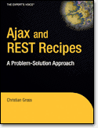
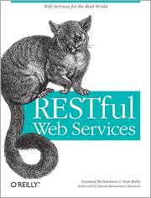
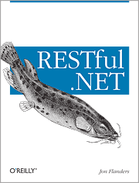
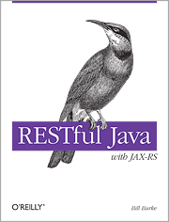
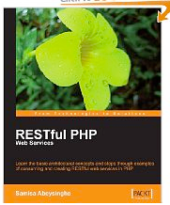
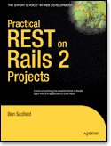
RESTful Web Services

Slide 13
The REST Architectural Style
REST: REpresentational State Transfer
REST is an architectural style for building distributed systems.
REST has been introduced in Roy Fielding’s Ph.D. thesis (Roy Fielding has been a contributor to the HTTP specification, to the apache server, to the apache community).
The WWW is one example for a distributed system that exhibits the characteristics of a REST architecture.

Slide 14
Principles of a REST Architecture
The state of the application is captured in a set of resources
  Users, photos, comments, tags, albums, etc.
Every resource is identified with a standard format (e.g. URL)
Every resource can have several representations
There is one unique interface for interacting with resources (e.g. HTTP methods)

Slide 15
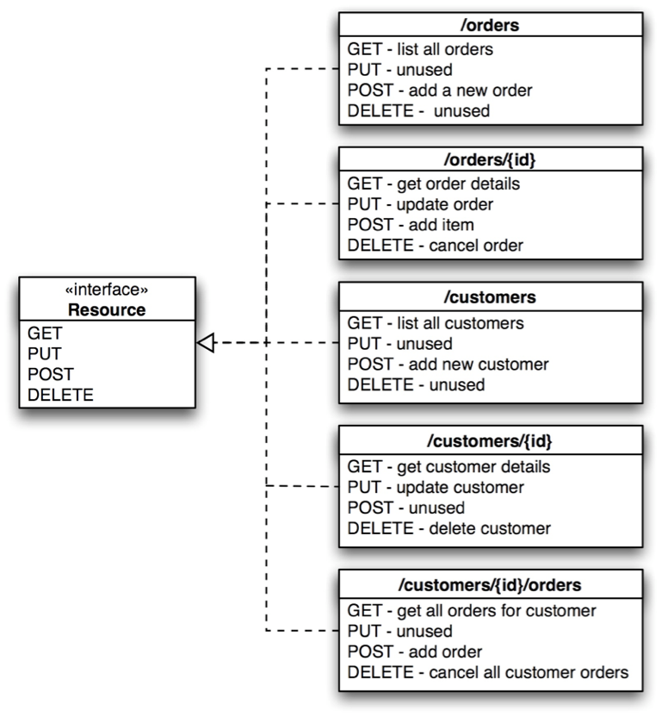
References
Very good article, with presentation of key concepts and illustrative examples:
  http://www.infoq.com/articles/rest-introduction
Suggestions for the design of “pragmatic APIs”
  http://www.vinaysahni.com/best-practices-for-a-pragmatic-restful-api

Slide 16
HTTP is a protocol for interacting with "resources"

Slide 17
What is a “Resource”
At first glance, one could think that a “resource” is a file on a web server:
  an HTML document, an XML document, a PNG document
That fits the vision of the “static content” web
But of course, the web is now more than a huge library of hypermedia documents:
  through the web, we interact with services and a lot of the content is dynamic.
  more and more, through the web we interact with physical objects (machines, sensors, actuators)
  We need a more generic definition for resources!

Slide 18
What is a “Resource”?
A resource is "something" that can be named and uniquely identified:
  Example 1: an article published in the "24 heures" newspaper
  Example 2: the collection of articles published in the sport section of the newspaper
  Example 3: a person’s resume
  Example 4: the current price of the Nestlé stock quote
  Example 5: the vending machine in the school hallway
  Example 6: the list of grades of the student Jean Dupont
URL (Uniform Resource Locator) is a mechanism for identifying resources
  Exemple 1: http://www.24heures.ch/vaud/vaud/2008/08/04/trente-etudiants-partent-rencontre-patrons
  Exemple 2: http://www.24heures.ch/articles/sport
  Exemple 5: http://www.smart-machines.ch/customers/heig/machines/8272

Slide 19
Resource vs. Representation
A "resource" can be something intangible (stock quote) or tangible (vending machine)
The HTTP protocol supports the exchange of data between a client and a server.
Hence, what is exchanged between a client and a server is not the resource. It is a representation of a resource.
Different representations of the same resource can be generated:
  HTML representation
  XML representation
  PNG representation
  WAV representation

Slide 20
Resource vs. Representation
HTTP provides the content negotiation mechanisms.
GET /books HTTP/1.1
Accept: application/json
HTTP/1.1 200 OK
Content-Type: application/json
[
{ "title": "Fahrenheit 451" }
]
GET /article/game-of-thrones HTTP/1.1
Accept: */*
HTTP/1.1 200 OK
Content-Type: text/html
<html>
<head>
<title>Game of Thrones</title>
</head>
<body>Awesome show!</body>
</html>

Slide 21
The toys tools we will use

Slide 22
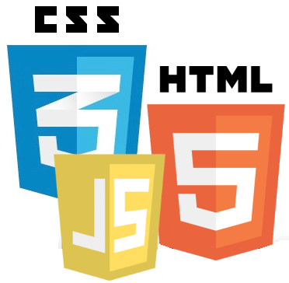
Languages, Platforms, Communities
?
Client
Server

Slide 23

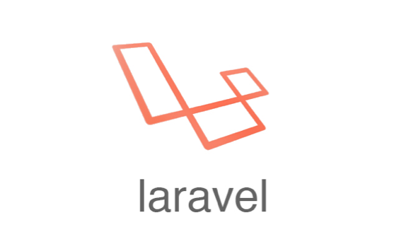









Languages, Platforms, Communities

Slide 24





JavaScript End to End
Client
Server

Slide 25


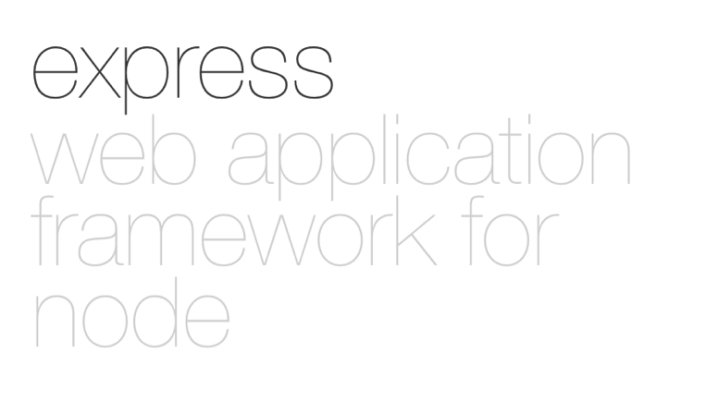





Use this to create and build the project
Use this to implement /api/endpoints
Use this to store data
Use this interact with mongoDB
Use this because it’s cool

Slide 26
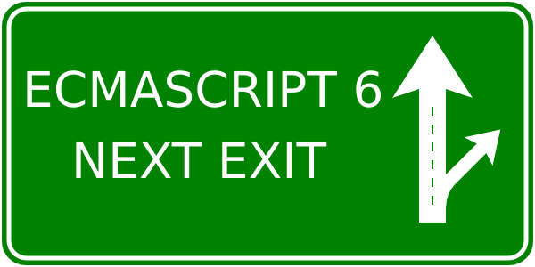
ECMAScript 6 is on its way (but not for us)
http://es6-features.org/

